Slide 1


Slide 2



TEAM 03 SECTION 01 (MEET THE TEAM)
Gowtham
Data Engineer
Akash Vemula
Data Scientist
Varun Yadhav
Data Analyst

Slide 3

Objective
Develop machine learning models to perform sentiment analysis on customer reviews, assessing the number of positive reviews and determining the product's overall quality.

Slide 4


Slide 5

Problem Statement
Companies selling smart devices, like Amazon Alexa, receive thousands of customer reviews, making it challenging to manually analyze feedback and identify areas for product improvement. Without an automated system, businesses may struggle to extract meaningful insights, resulting in missed opportunities to enhance product quality, customer satisfaction, and market competitiveness.

Slide 6
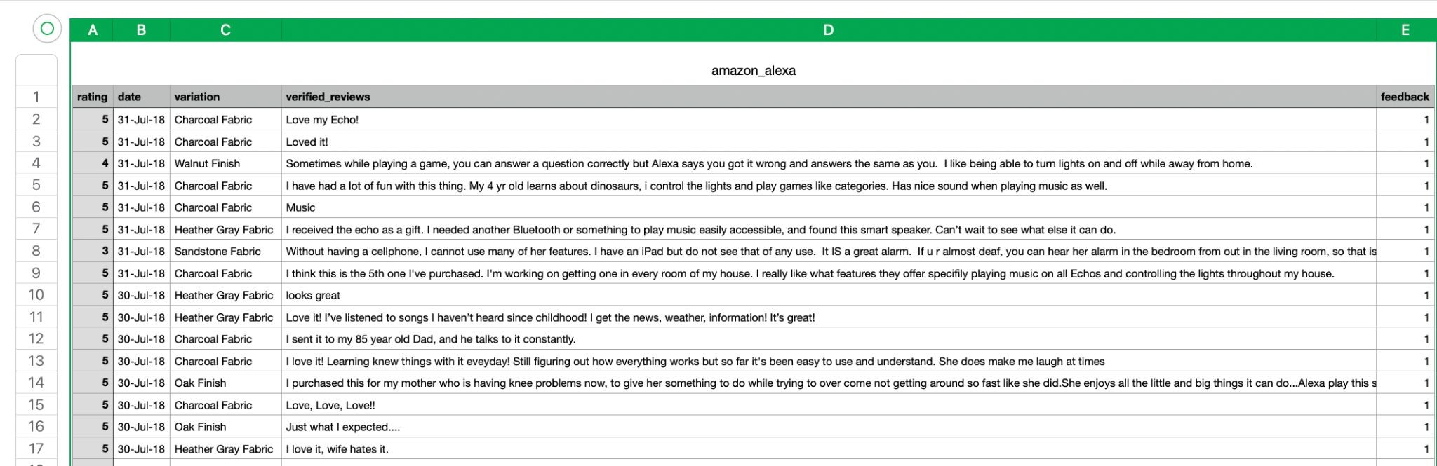
DataSet Sample

Slide 7
Dataset
This dataset consists:
3000 Amazon customer reviews (input text),
star ratings,
date of review,
variant and feedback of various amazon Alexa products like Alexa Echo, Echo dots, Alexa Fire Sticks etc.

Slide 8
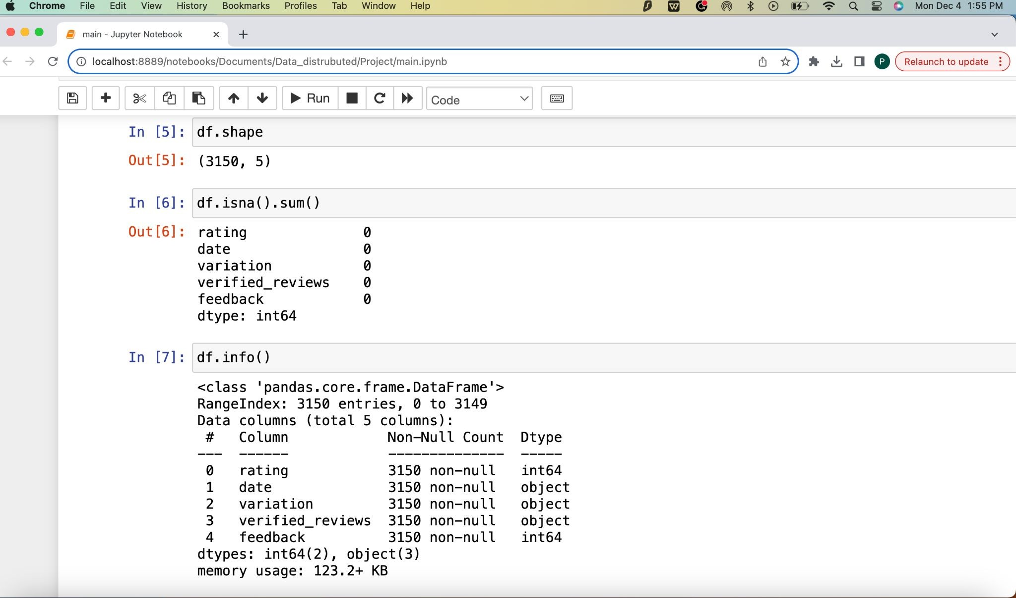
Analysis of Data

Slide 9
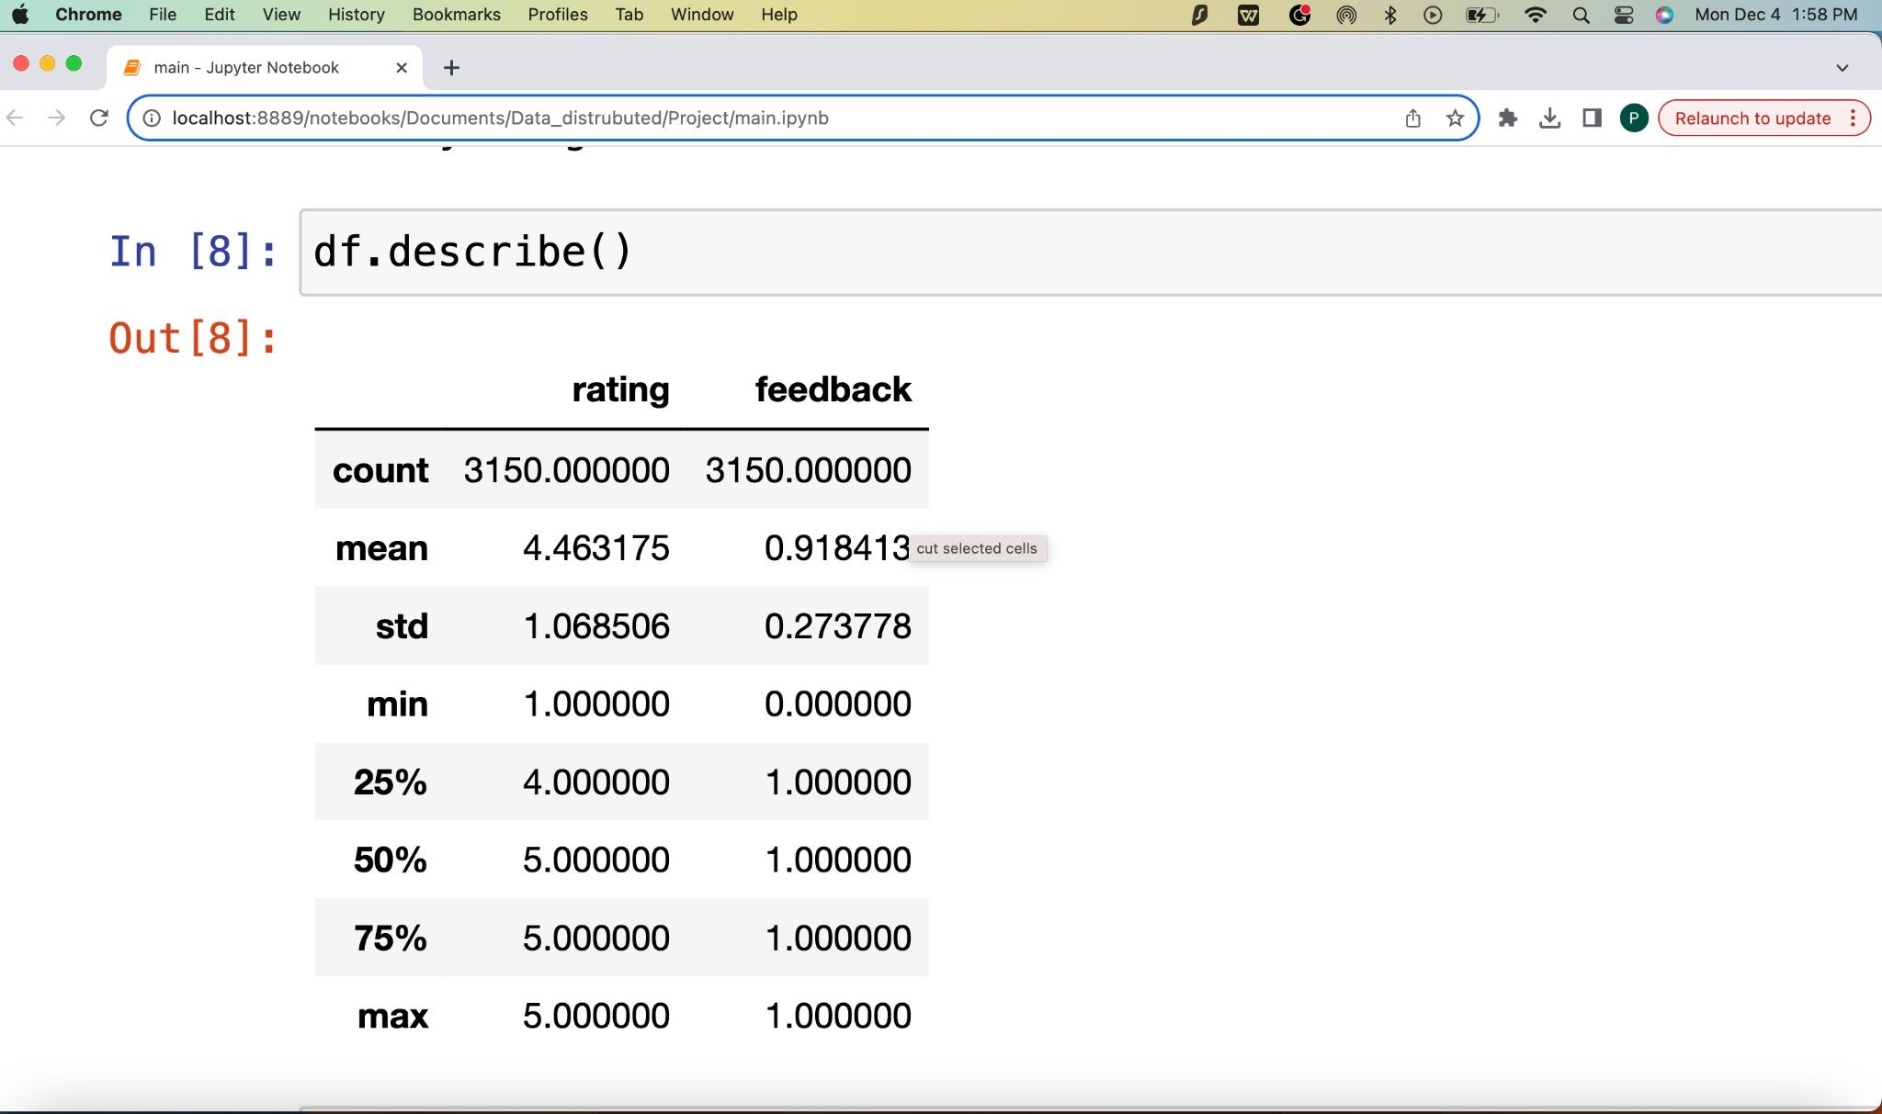
Analysis of Data

Slide 10
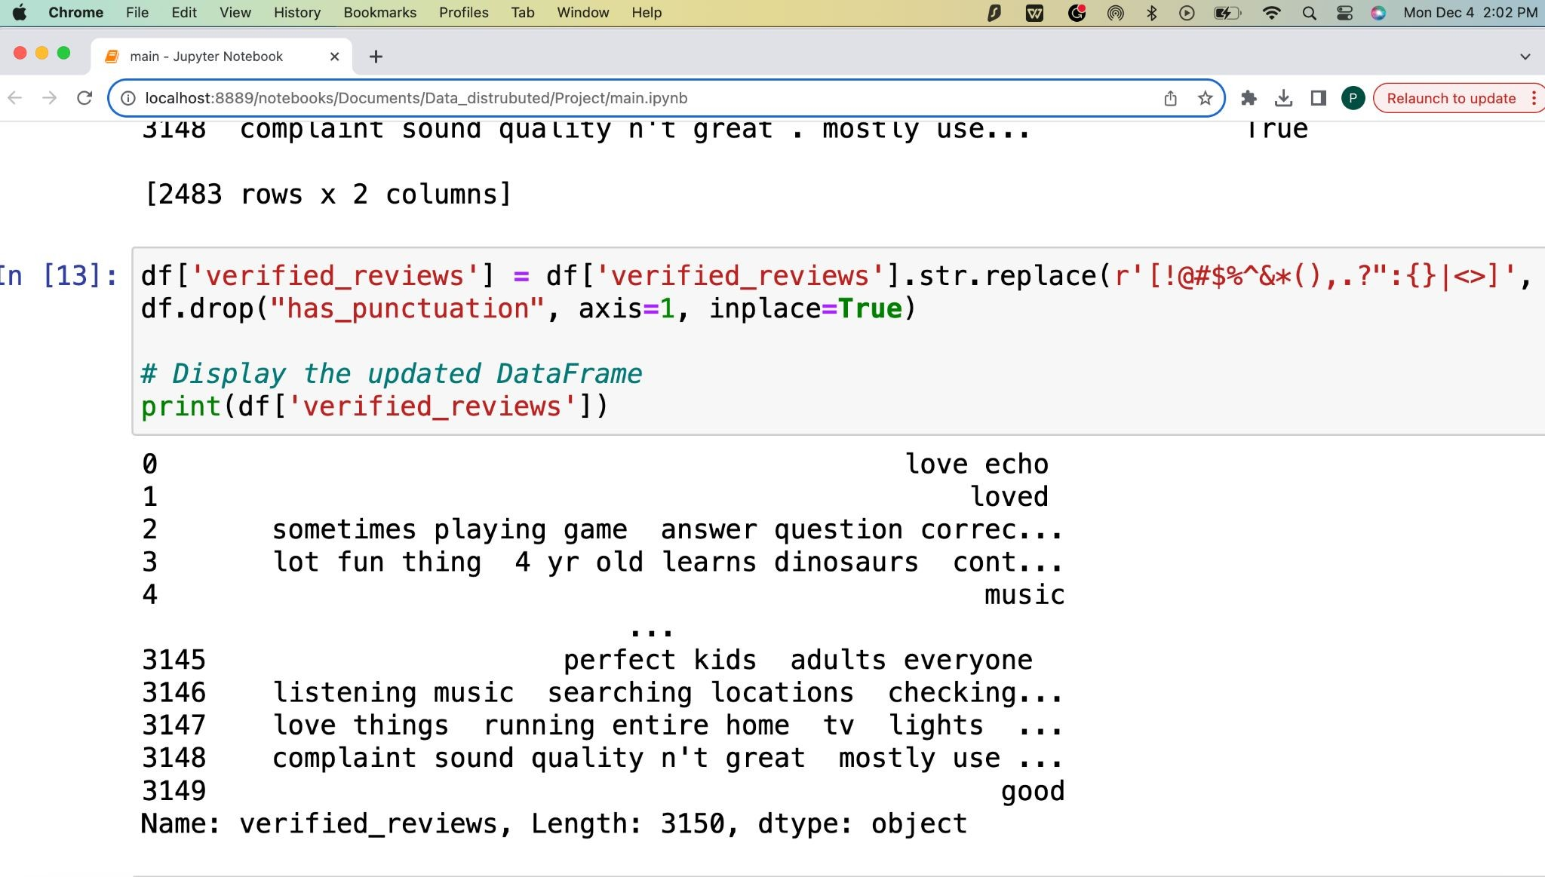
Cleaning of Data

Slide 11
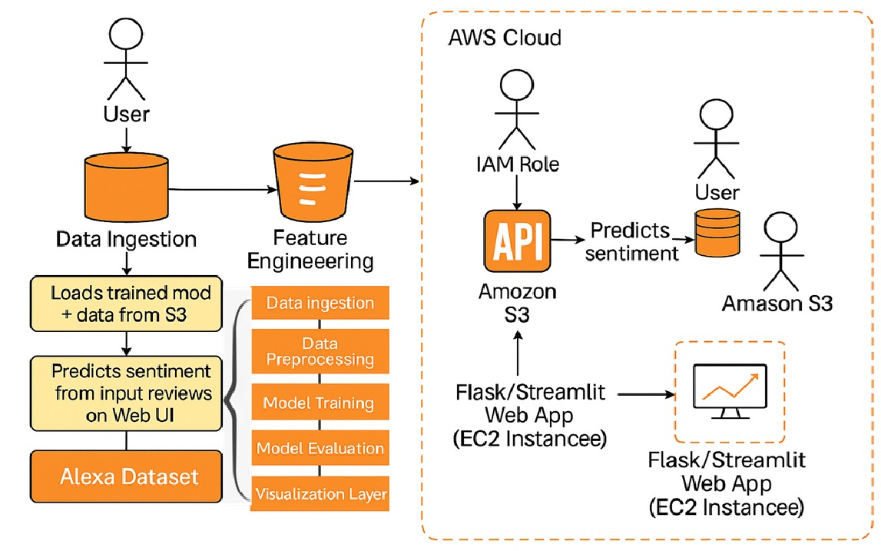


Slide 12
Algorithms
1. Naive Bayes Classifier
2. Random Forest Classifier
3. Decision Tree

Slide 13
Naive Bayes Classifier
The Naïve Bayes classifier is a supervised machine learning algorithm, which is used for classification tasks, like text classification.
It is also part of a family of generative learning algorithms, meaning that it seeks to model the distribution of inputs of a given class or category.
Unlike discriminative classifiers, like logistic regression, it does not learn which features are most important to differentiate between classes.

Slide 14
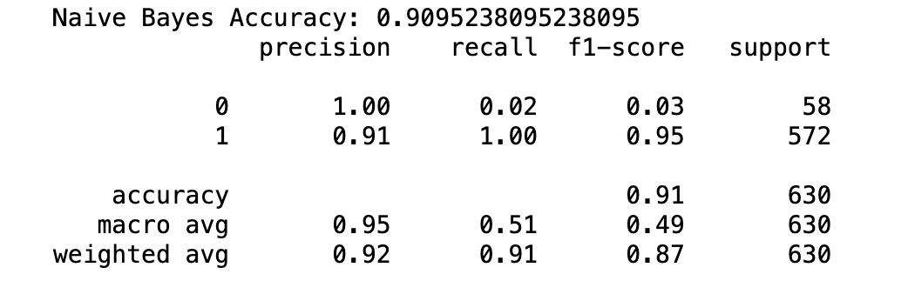
Naive Bayes Classifier

Slide 15
Decision Tree
A decision tree is a non-parametric supervised learning algorithm.
It is utilized for both classification and regression tasks.
It has a hierarchical, tree structure, which consists of a root node, branches, internal nodes and leaf nodes.

Slide 16
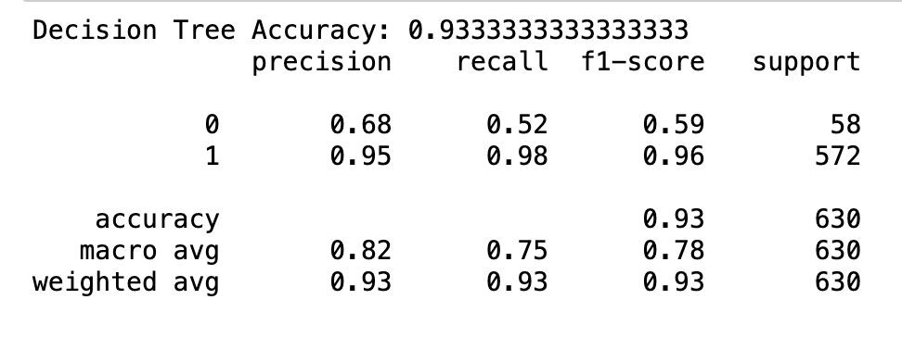
Decision Tree

Slide 17
Random Forest Classifier
Random forest is a commonly-used machine learning algorithm which combines the output of multiple decision trees to reach a single result.
Its ease of use and flexibility have fueled its adoption, as it handles both classification and regression problems.

Slide 18
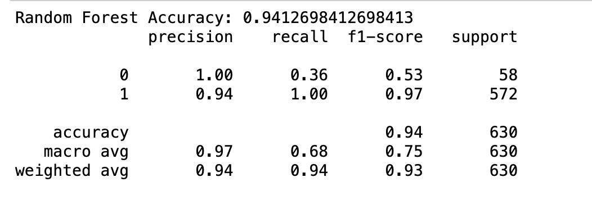
Random Forest Classifier

Slide 19
Accuracy
Naive Bayes Classifier: 0.9095238095238095
Random Forest Classifier: 0.9412698412698413
Decision Tree: 0.9333333333333333

Slide 20
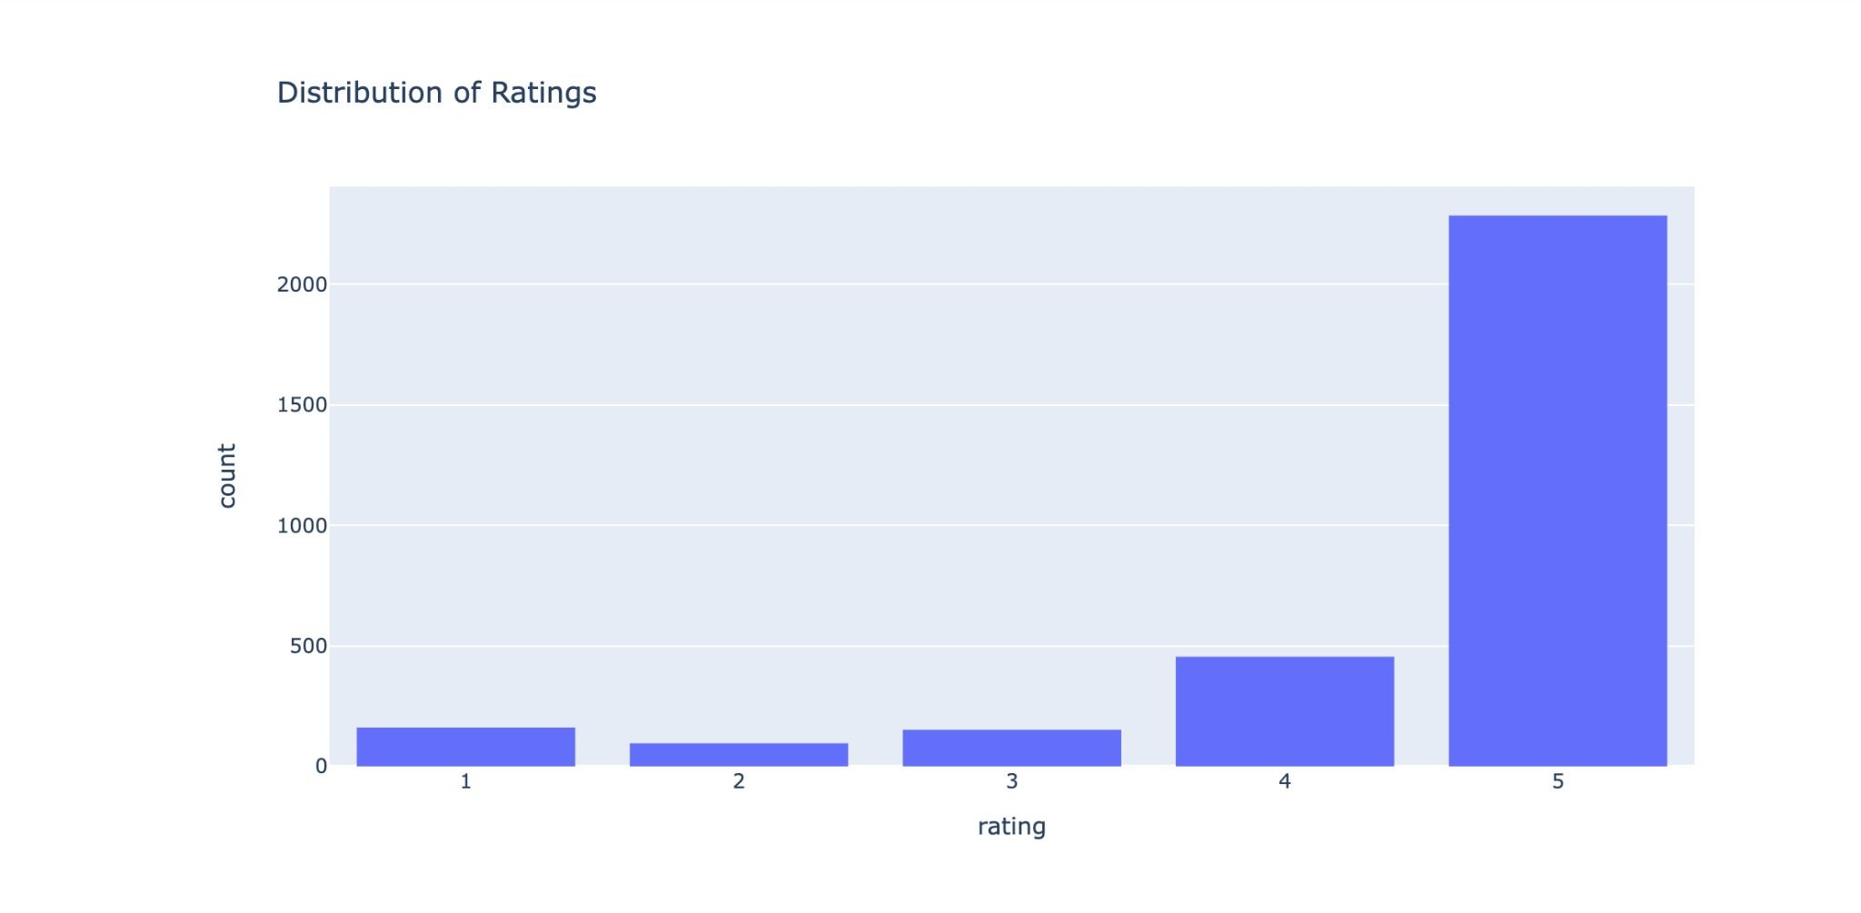
Visualization of Data

Slide 21
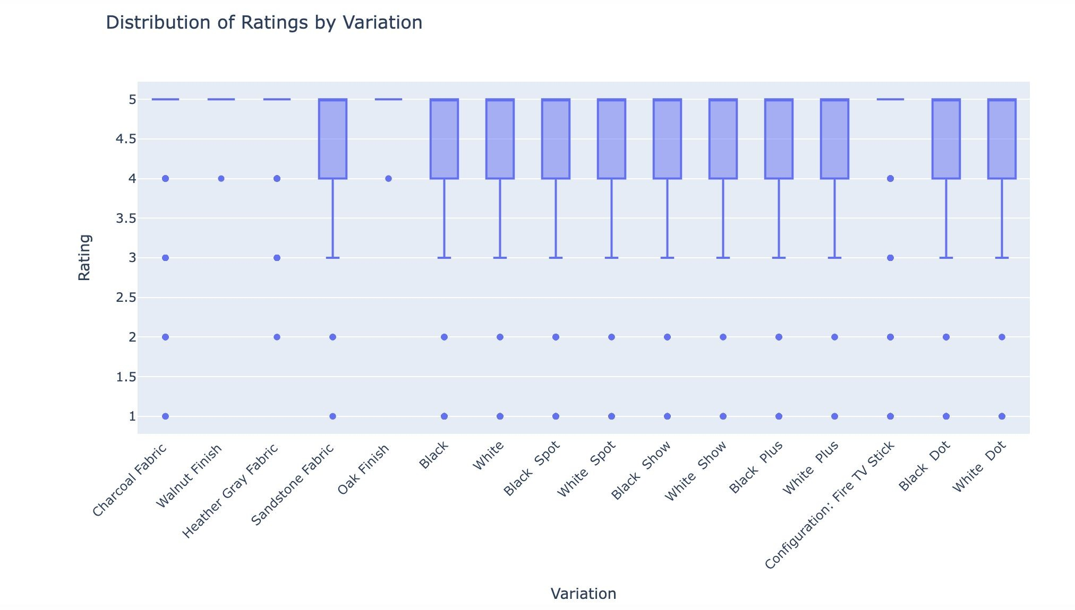
Visualization of Data

Slide 22
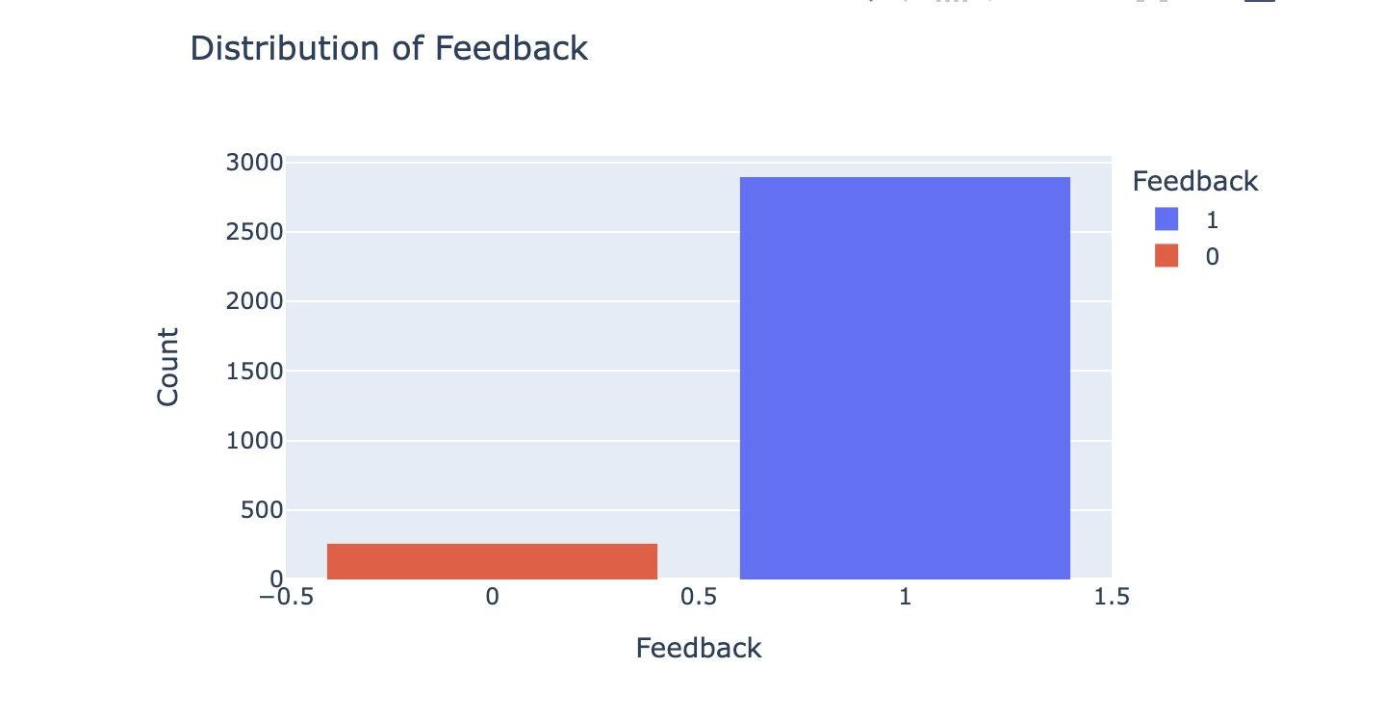
Visualization of Data

Slide 23
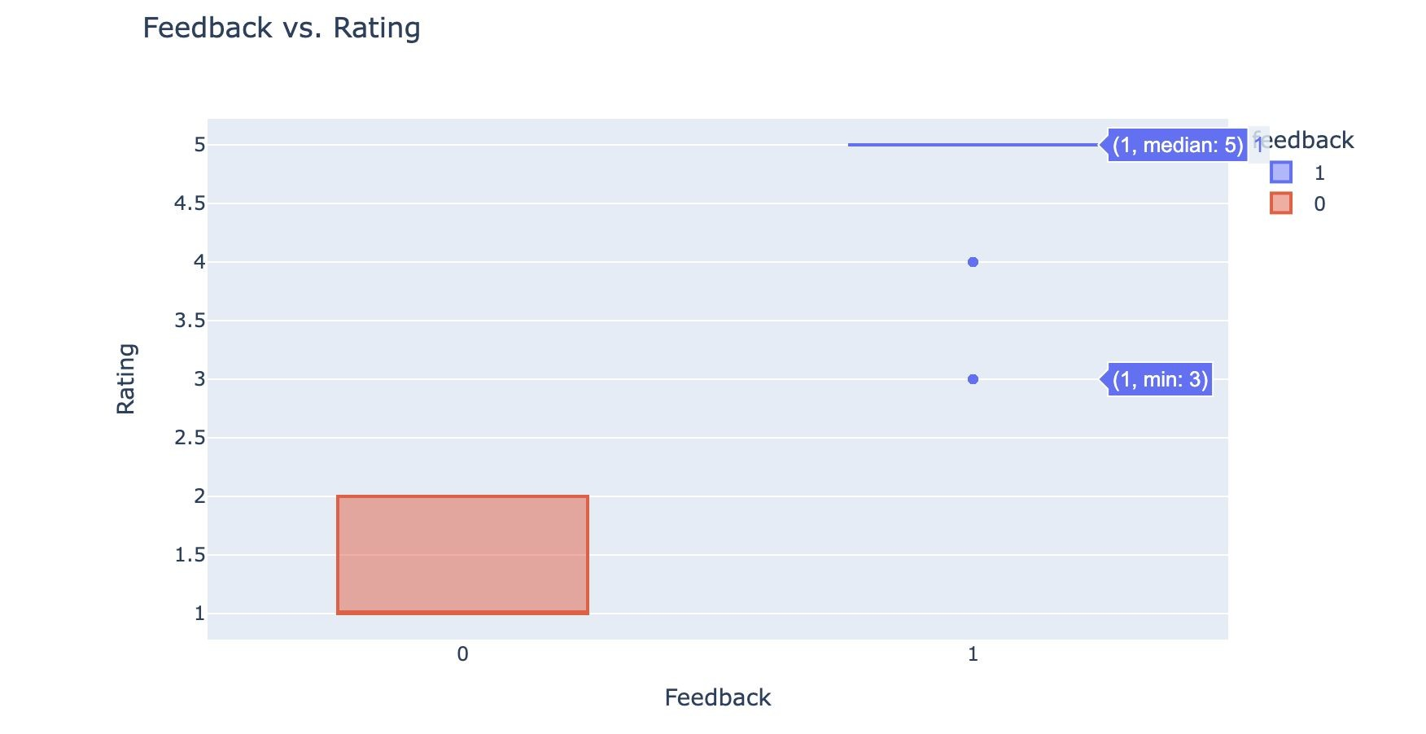
Visualization of Data

Slide 24
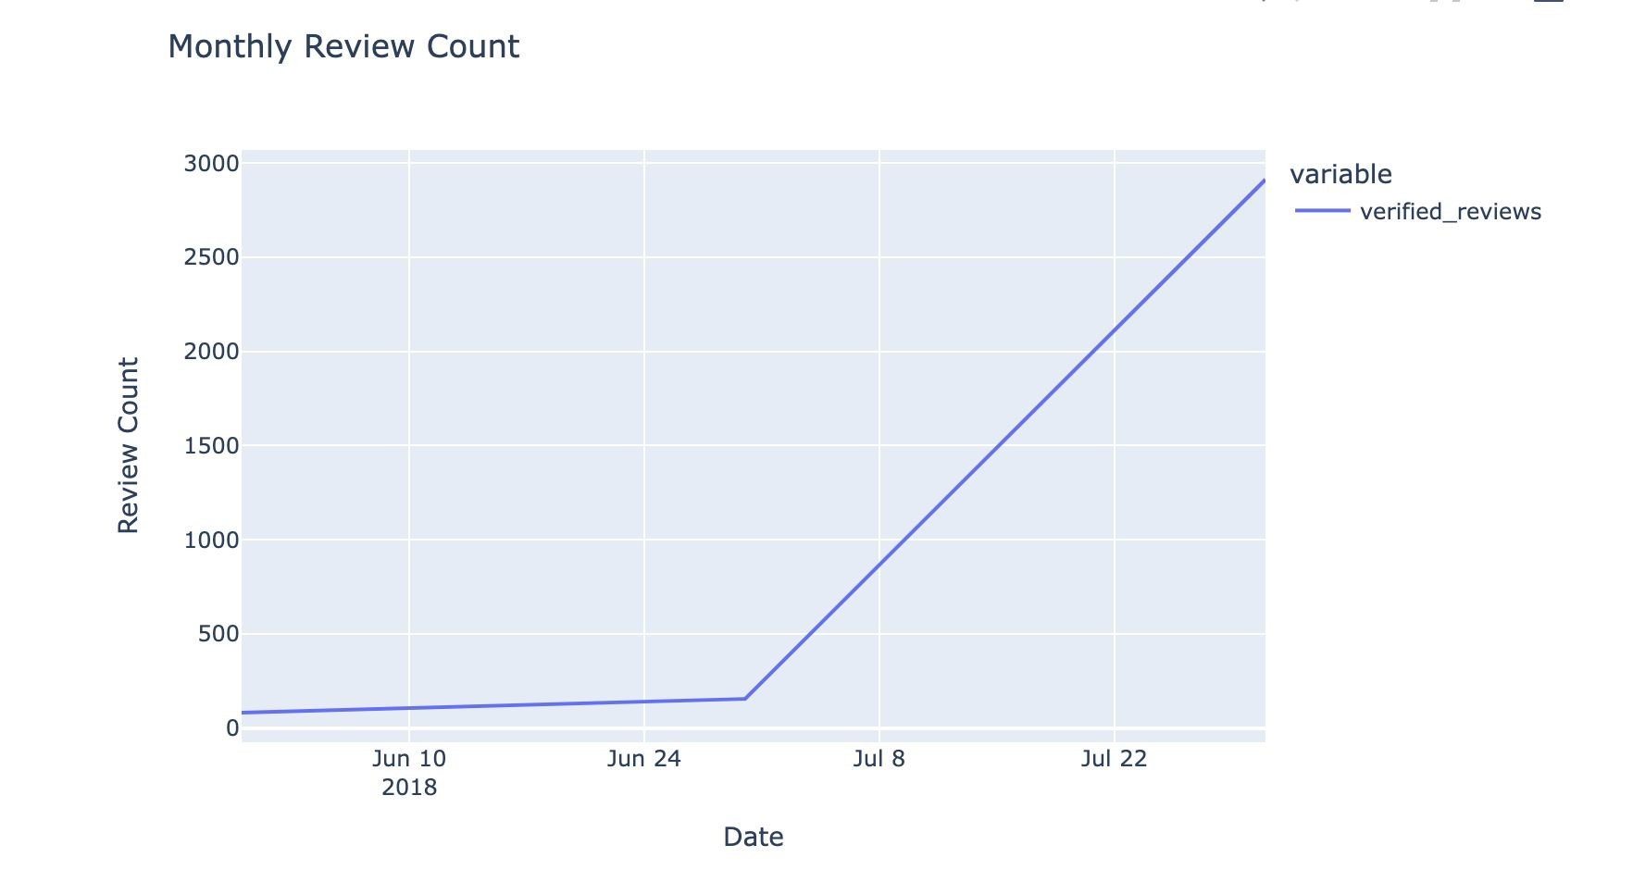
Visualization of Data

Slide 25
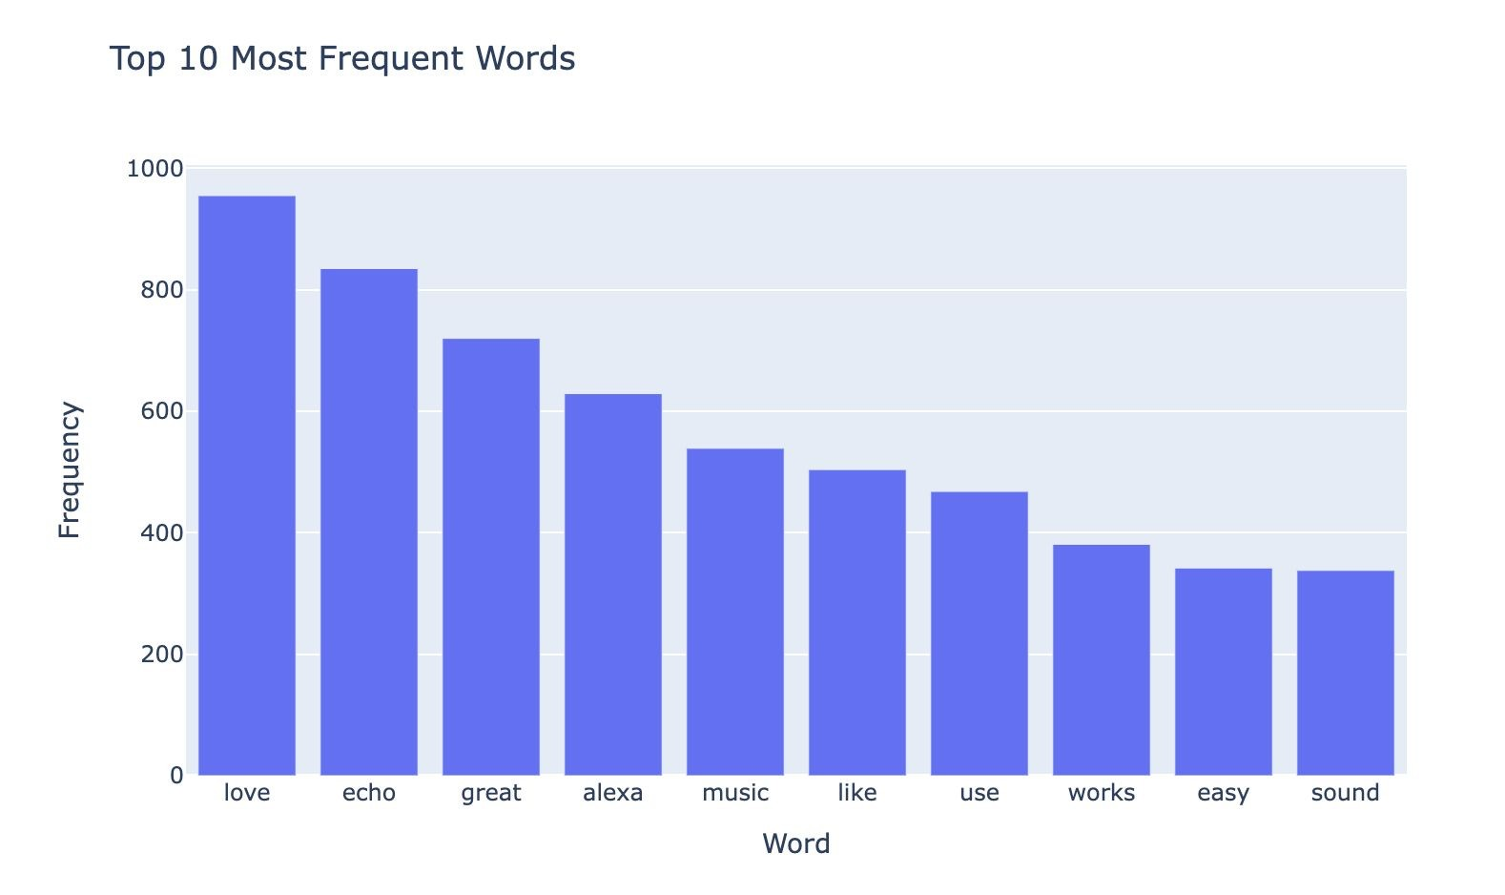
Visualization of Data

Slide 26
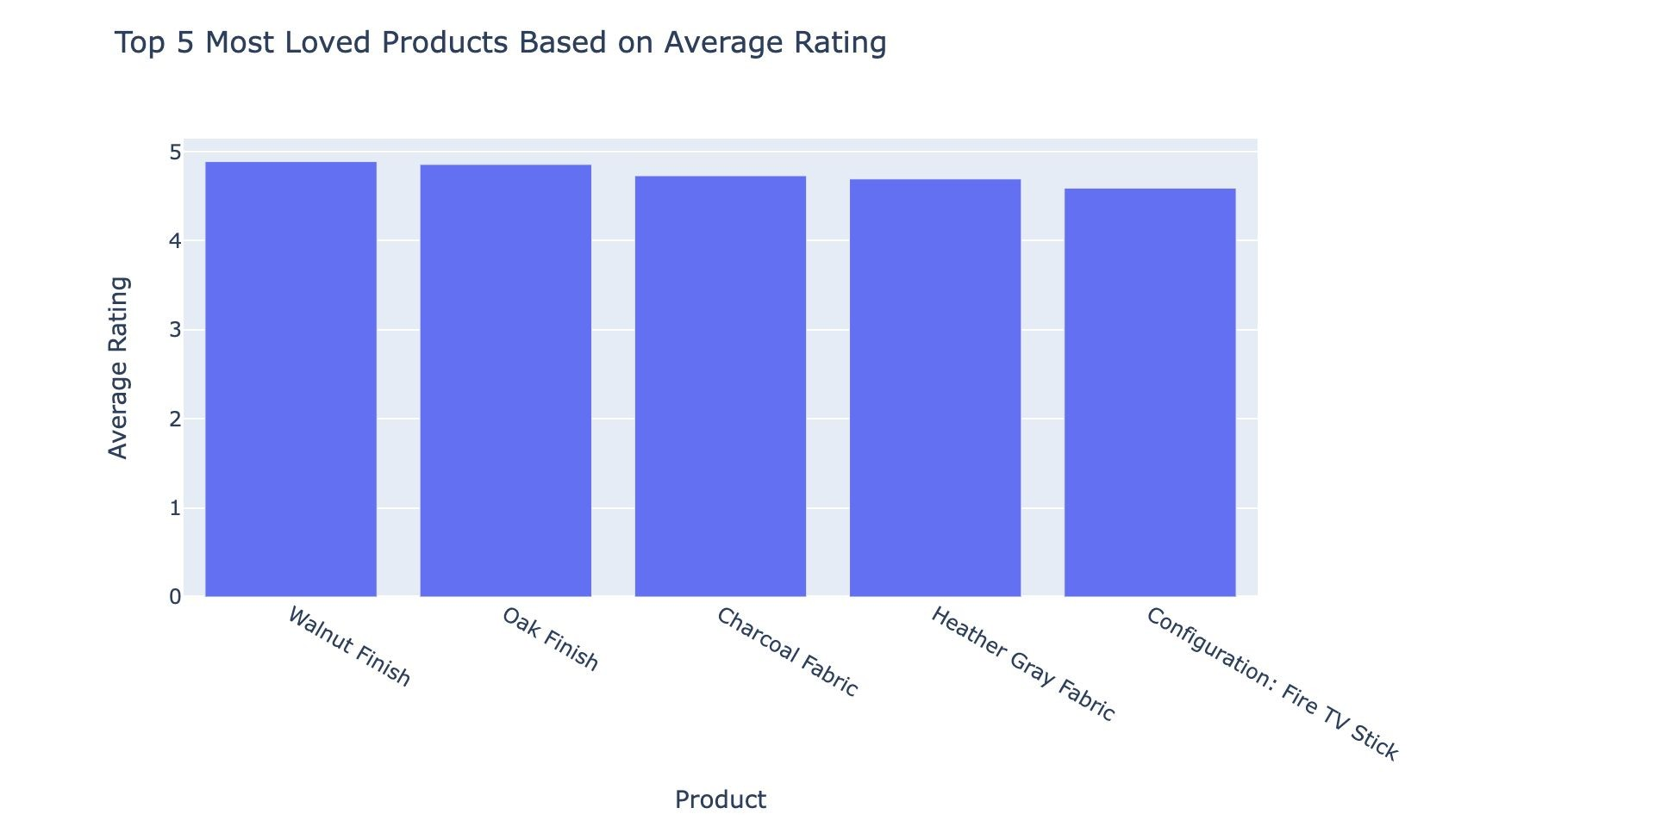
Visualization of Data

Slide 27
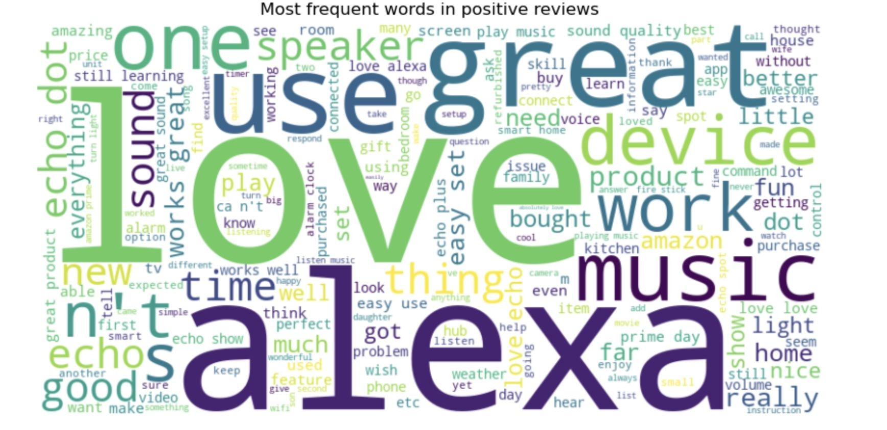
Visualization of Data

Slide 28
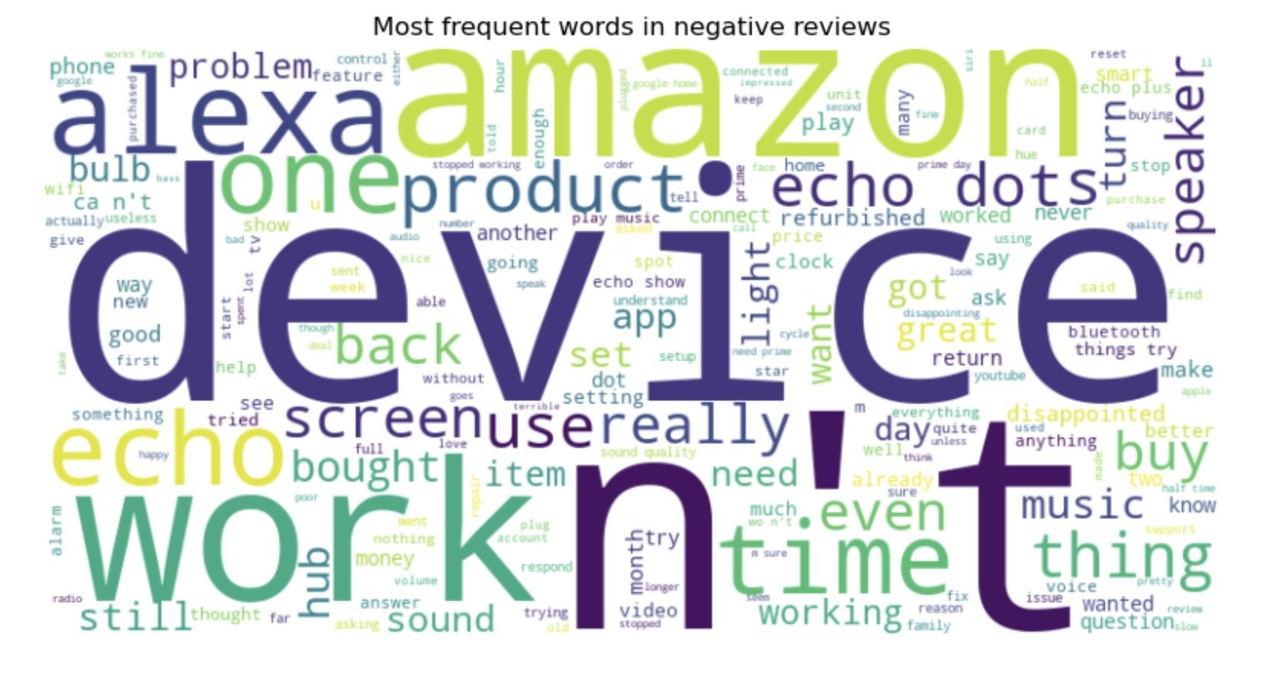
Visualization of Data

Slide 29
Links
Github:
https://github.com/AkashVemula99/AI-Driven-Review-Analytics-for-Product-Enhancement/tree/Updated
Dataset:
https://www.kaggle.com/datasets/sid321axn/amazon-alexareviews

Slide 30
Conclusion
In summary, we employed three algorithms, and the random forest algorithm demontrated higher accuracy for the Amazon Alexa review dataset.
Our data science project, centered around Amazon Alexa reviews, strives to provide valuable insights, assessing the overall merit of Alexa as a product through a thorough analysis of custmoers historical reviews.

Slide 31

Thank you!!!

